Slide 1
How short tandem repeats (STR) contribute to variation in gene expression
Oral Presentation, November 2023

Slide 2
Short tandem repeats (STR) and their importance
1) STR variation and distribution
AGC
AGC
AGC
AGC
AGC
1
Notes:
The plan of a presentation. Three sections we are talking about.

Slide 3
Short tandem repeats (STR) and their importance
1) STR variation and distribution
AGC
AGC
AGC
AGC
AGC
2) STRs serve as regulatory DNA elements
Enhancer
Preferential
binding
TF
1
Notes:
The plan of a presentation. Three sections we are talking about.

Slide 4
Short tandem repeats (STR) and their importance
1) STR variation and distribution
3) STR variation under selection
AGC
AGC
AGC
AGC
AGC
Exon
STR expansion
under selection
2) STRs serve as regulatory DNA elements
Enhancer
Exon
Preferential
binding
TF
1
Notes:
The plan of a presentation. Three sections we are talking about.

Slide 5
STR variation and distribution
Short tandem repeats (= microsatellites) are the units of 1-6 bp that repeat head-to-tail in a tandem fashion.
AGC
AGC
AGC
AGC
AGC
ACACAT
ACACAT
ACACAT
ACACAT
2

Slide 6
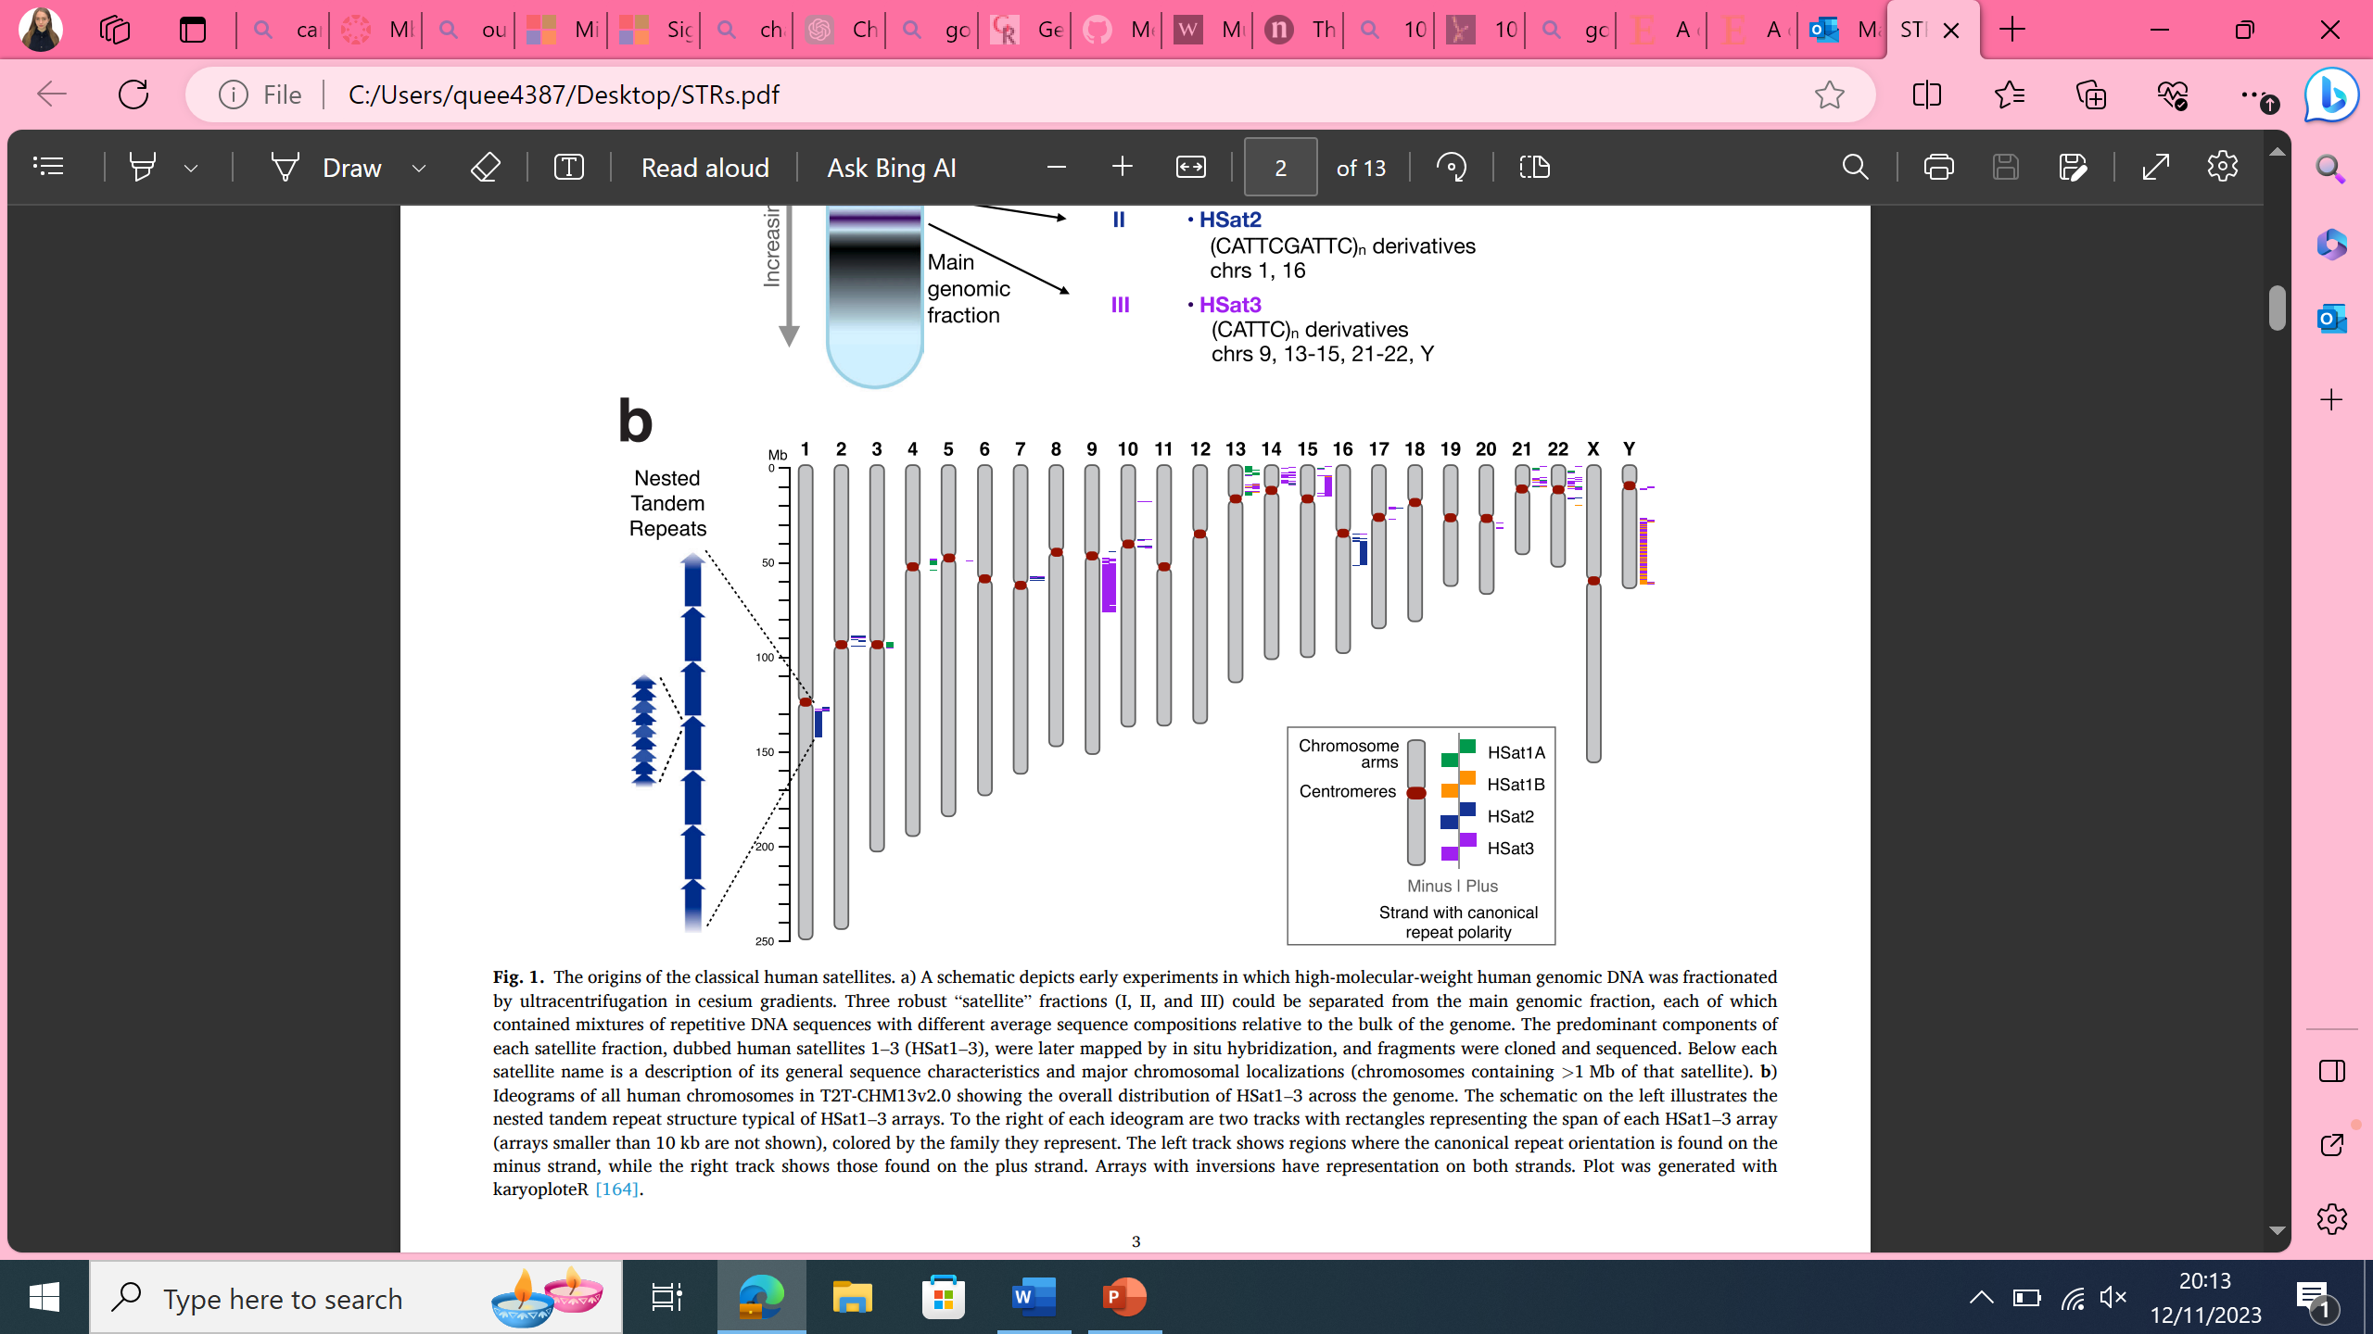
STR variation and distribution
They are ubiquitous in eukaryotic and prokaryotic genomes, with ~ 4,500,000 loci covering up to 2.5% of the human genome.
Ideogram of all human chromosomes (T2T-CHM13 ) with annotated human satellites of at least 10 kb length.
Source: Altemose N. A classical revival: Human satellite DNAs enter the genomics era. Sem.in cell and dev. Bio. 2022
3

Slide 7
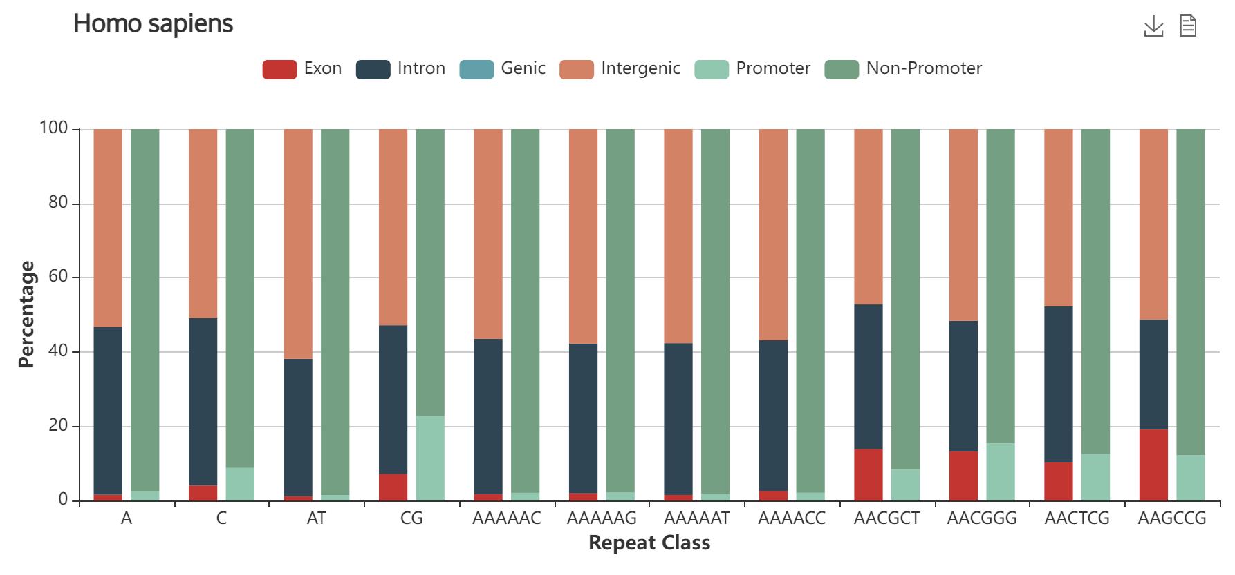
STR variation and distribution
3. They are non-randomly distributed in eukaryotic genomes.
Repeat combinations show various preferences in DNA localisation.
Mostly found in intergenic and intronic regions.
Source: MSDB (MicroSatellite DataBase), Avvaru A.K. et al. Nucleic Acid Research. 2020
4
Notes:
Explain the graph

Slide 8
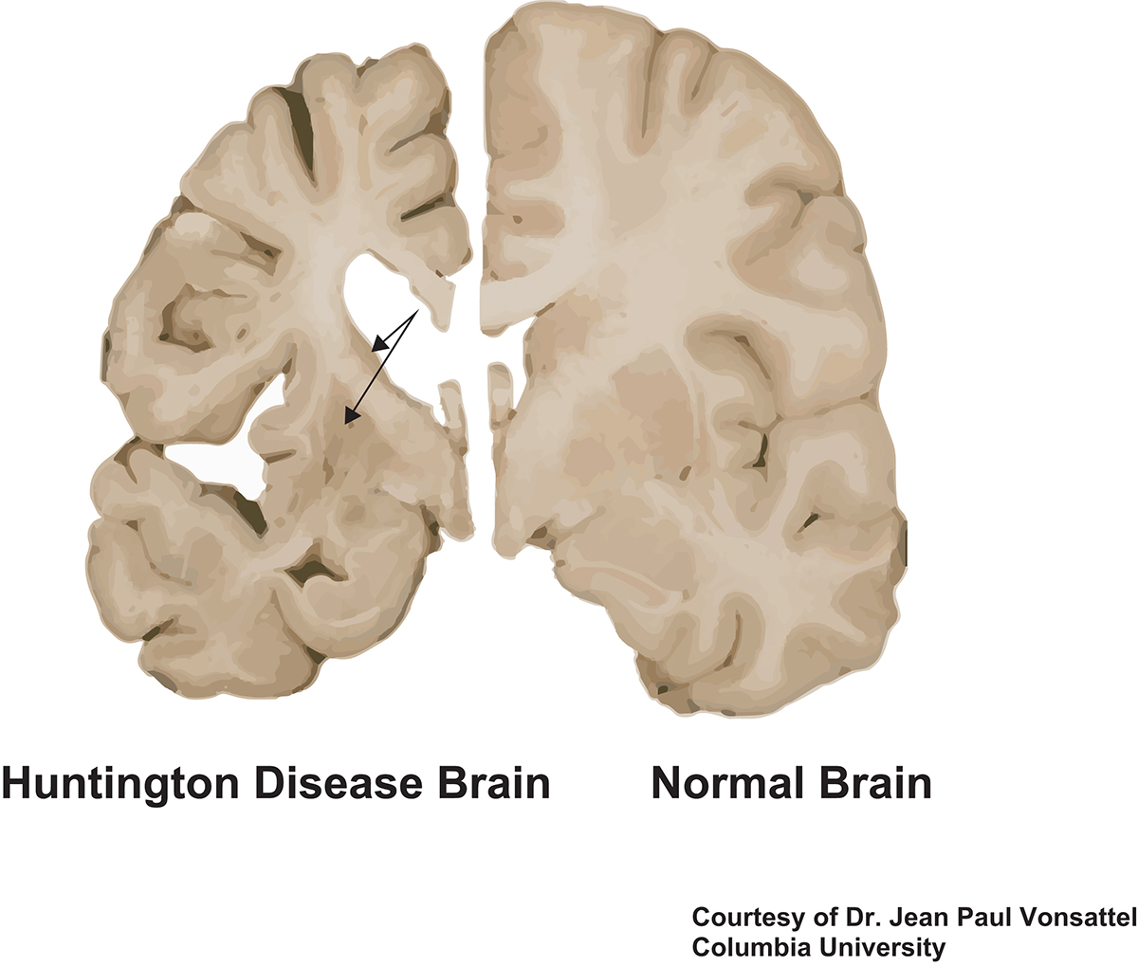
STR variation and distribution
4. STRs show high rates of length mutations with a preference for elongation.
Frequent copy number changes and polyallelic nature
The polymorphism in STRs is associates with variation in phenotypic traits and is linked to neurological diseases.
AGC
AGC
AGC
AGC
AGC
AGC
AGC
AGC
AGC
AGC
AGC
AGC
Opportunity for modulating complex phenotypes through variation in repeat length.
Source: Ellegren H. Microsatellites: simple sequences with complex evolution. Nat.Rev.Genet. 2004
5

Slide 9
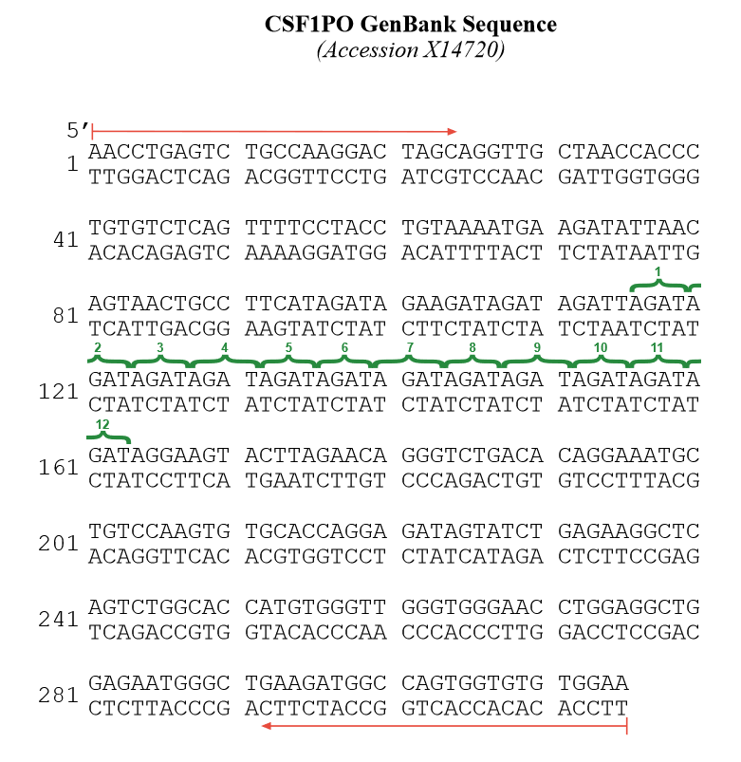
Challenges in STRs sequence and function research
How to study mechanisms behind the association of traits with STR variation?
The new T2T-CHM13 assembly with fully annotated microsatellites using long-read data.
New algorithms for alignment -> better STR establishment.
New methods for the association studies.
Source: Jakubovsky et al. Properties of structural variants and short tandem repeats associated with gene expression and complex traits. Nat.Communications. 2020
6
Notes:
Separator slide. We are with the previous section, moving to the next one.

Slide 10
STRs as quantitative trait loci (QTL)
STR sequence variation has functional consequences on gene expression, DNA methylation, histone modifications and chromatin accessibility
AGC
AGC
AGC
AGC
AGC
AGC
AGC
AGC
AGC
AGC
AGC
AGC
Methylation
of histones
Enhancer
Preferential
binding
TF
CpG methylation in promotor region
Fine-tune expression
Promotor
Modulate chromatin accessibility
Regulate DNA methylation
Source: Verbiest M. et al. Mutation and selection processes regulating short tandem repeats give rise to genetic and phenotypic diversity across species. Evolutionary biology. 2022
7

Slide 11
Do STRs serve as regulatory DNA elements?
STRs directly bind transcription factors to tune gene expression
Enhancer
Short tandem repeat (STR)
STRs are different from the binding motifs. Therefore multiple TFs could be recruited.
STRs tune local TF concentration and binding responses to regulate gene expression.
+
Binding motif
++
TF occupancy
+++
+
-
Transcription factor (TF)
Source: Horton C. A. et al. Short tandem repeats bind transcription factors to tune eukaryotic gene expression. Science. 2023
8

Slide 12
Do STRs serve as regulatory DNA elements?
Engineered enhancer regions to see how likely the transcription factors (TFs) are to bind
Enhancer with STRs
Enhancer without STRs
E-box
E-box
TF
Enhancer
Short tandem repeat
Source: Horton C. A. et al. Short tandem repeats bind transcription factors to tune eukaryotic gene expression. Science. 2023
9
Notes:
ΔΔGs were calculated relative to the overall median value for E-box consensus surrounded by random flanking sequence. Light grey dots show all measurements; red circles indicate median values per oligo.

Slide 13
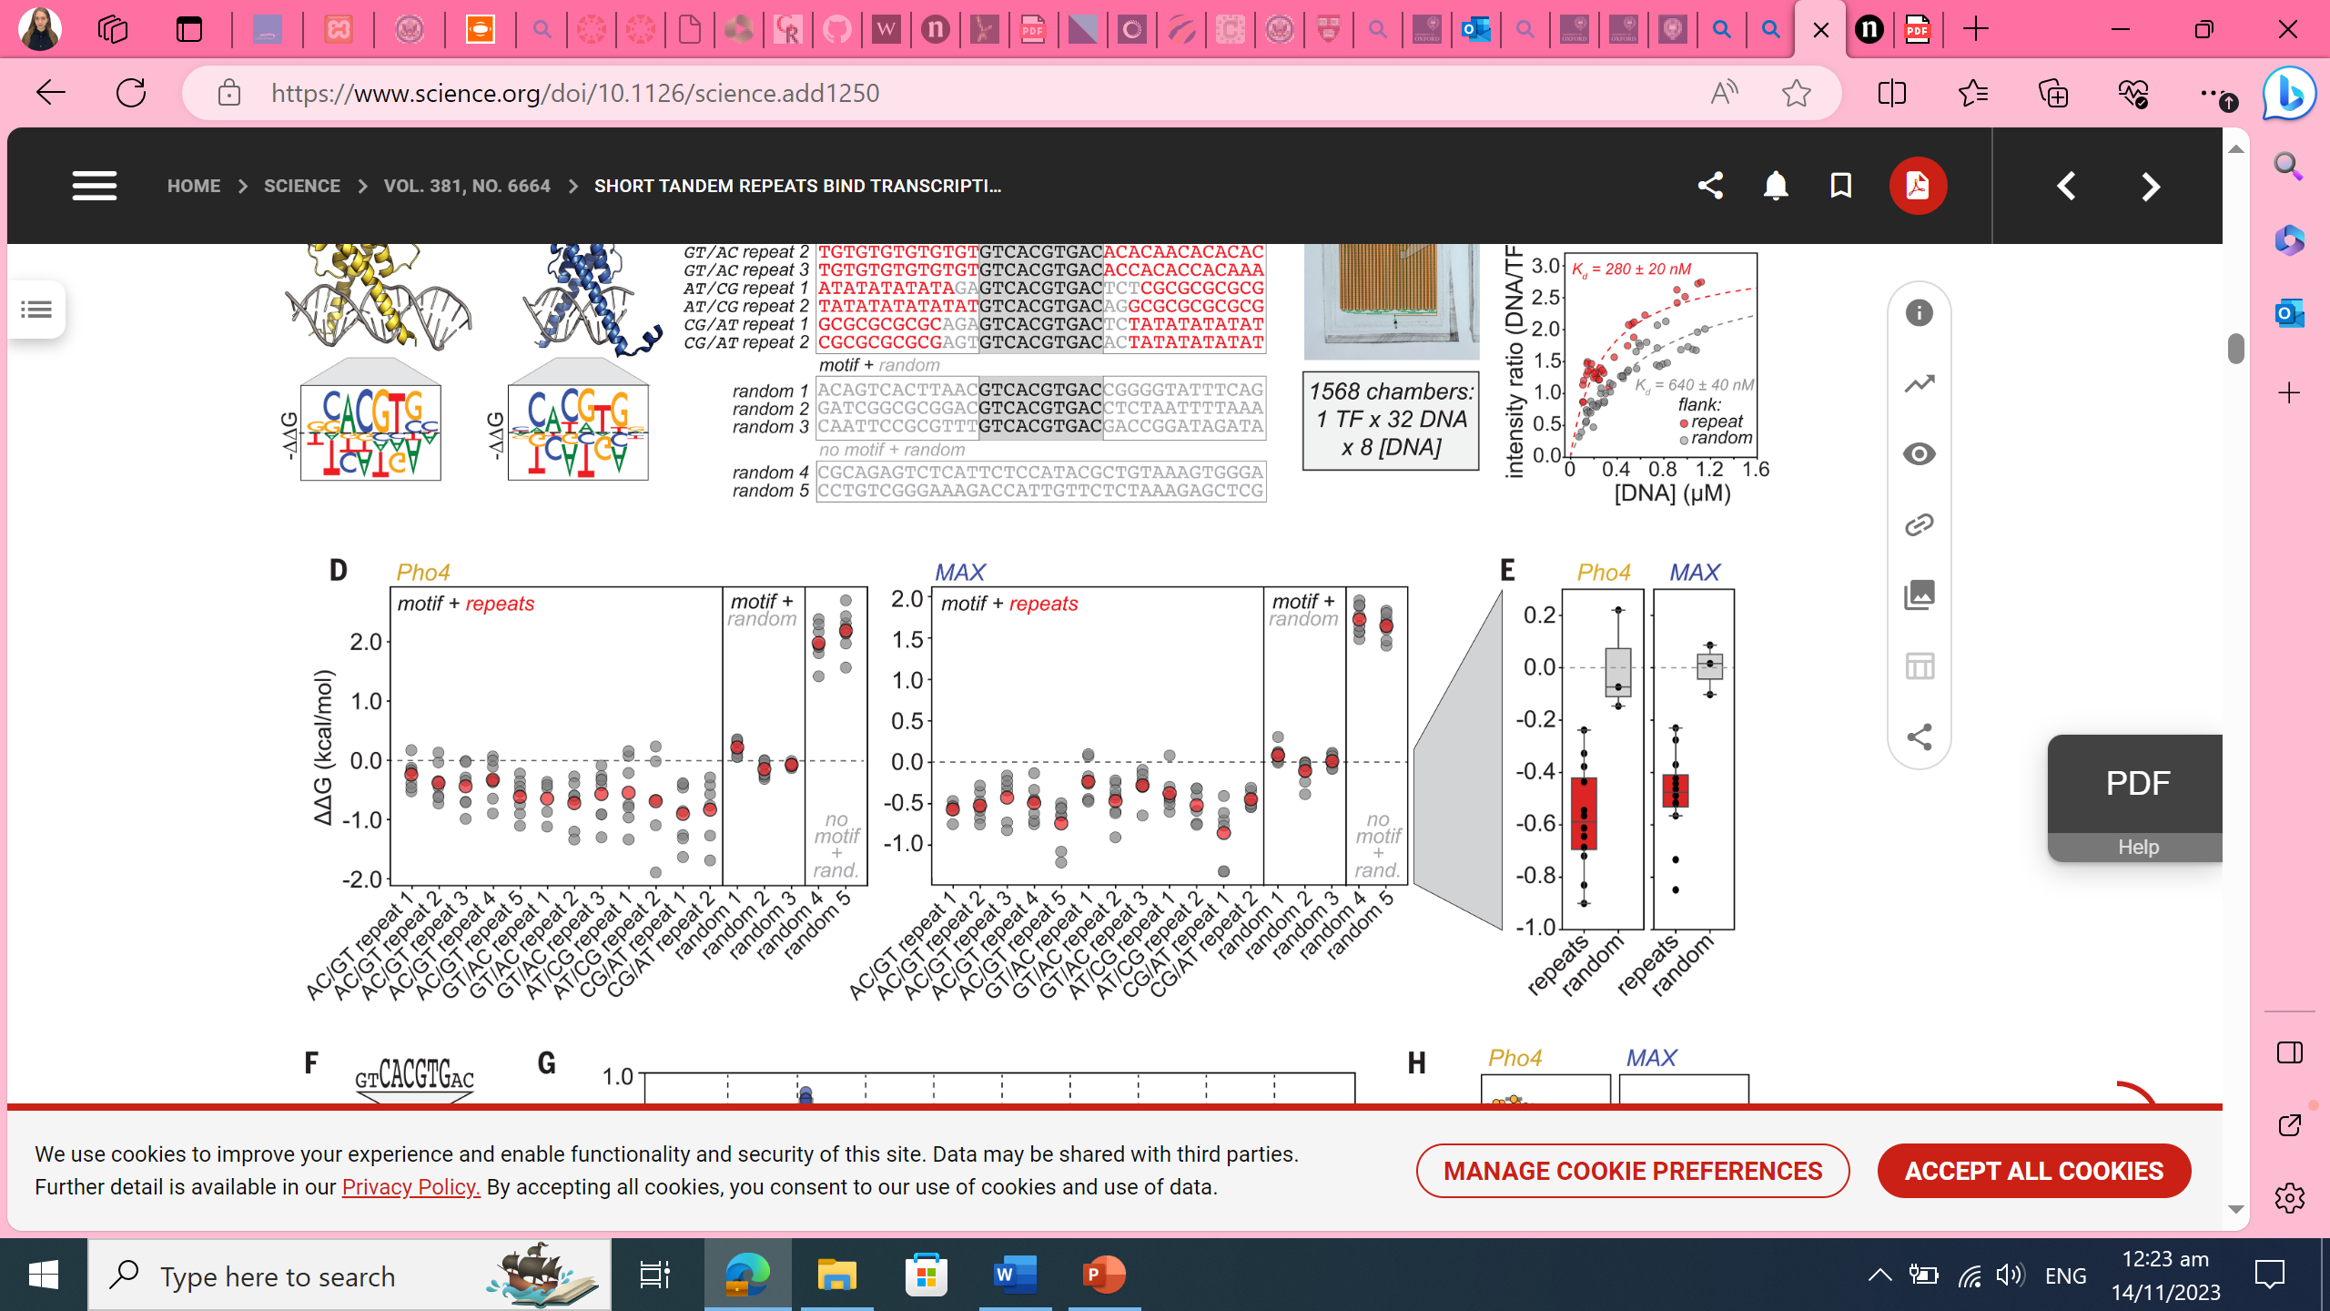

Do STRs serve as regulatory DNA elements?
STRs around binding motifs significantly lower the Gibb’s free energy
for binding of transcription factors (TF).
Ç√
Ç√
Source: Horton C. A. et al. Short tandem repeats bind transcription factors to tune eukaryotic gene expression. Science. 2023
10
Notes:
ΔΔGs were calculated relative to the overall median value for E-box consensus surrounded by random flanking sequence. Light grey dots show all measurements; red circles indicate median values per oligo.

Slide 14
Do STRs serve as regulatory DNA elements?
STRs around binding motifs significantly lower the Gibb’s free energy
for binding of transcription factors (TF).
Ç√
Ç√
Source: Horton C. A. et al. Short tandem repeats bind transcription factors to tune eukaryotic gene expression. Science. 2023
10
Notes:
ΔΔGs were calculated relative to the overall median value for E-box consensus surrounded by random flanking sequence. Light grey dots show all measurements; red circles indicate median values per oligo.

Slide 15
Do STRs serve as regulatory DNA elements?
STRs around binding motifs significantly lower the Gibb’s free energy
for binding of transcription factors (TF).
Ç√
Ç√
TF more vigorously binds to enhancers with STR.
Source: Horton C. A. et al. Short tandem repeats bind transcription factors to tune eukaryotic gene expression. Science. 2023
10
Notes:
ΔΔGs were calculated relative to the overall median value for E-box consensus surrounded by random flanking sequence. Light grey dots show all measurements; red circles indicate median values per oligo.

Slide 16
Do STRs serve as regulatory DNA elements?
Searched for association between
the length of the STR and the DNA methylation levels.
Short tandem repeat
Enhancer
Methylation mark
Source: Martin-Trujillo A. et al. Genome-wide evaluation of the effect of short tandem repeat variation on local DNA methylation. Genome research. 2023
11

Slide 17
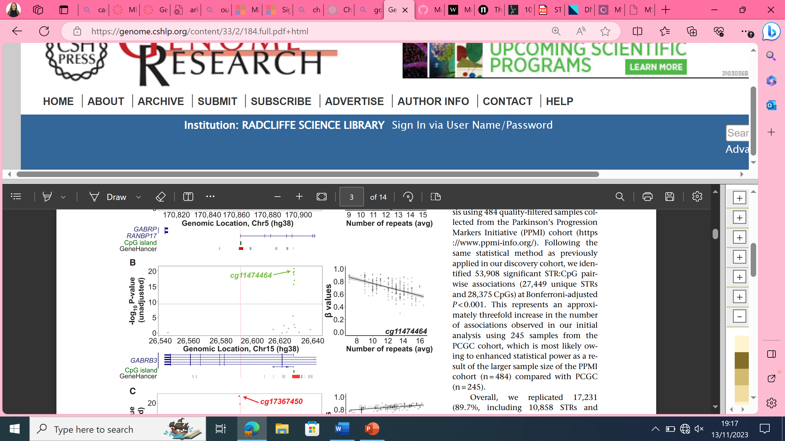
Do STRs serve as regulatory DNA elements?
STRs modulate local DNA methylation profiles
Manhattan plot for GABRB3 –
gene plays a role in neurotransmission and is involved in development of encephalopathy.
Each dot is a CpG, significant association between the STR length and methylation is established in the enhancer region.
Source: Martin-Trujillo A. et al. Genome-wide evaluation of the effect of short tandem repeat variation on local DNA methylation. Genome research. 2023
11

Slide 18
Do STRs serve as regulatory DNA elements?
The longer the STR the less methylated enhancer is.
Methylation index
The length of the STR region (30 bp away from the enhancer) is negatively correlated with the CpG methylation index.
Source: Martin-Trujillo A. et al. Genome-wide evaluation of the effect of short tandem repeat variation on local DNA methylation. Genome research. 2023
12

Slide 19
Do STRs serve as regulatory DNA elements?
Fine tuning of expression often results in phenotypic variation
Gene
A link between tandem repeat length and phenotype could have an adaptive role.
Through their high mutation rates, STRs yield diverse range of phenotypes that evolve rapidly and reversibly
Gene
Gene
Source: Vinces M. et al. Unstable Tandem Repeats in Promoters Confer Transcriptional Evolvability. Science. 2009.
13

Slide 20
Conclusions
Due to the STRs regulatory function and their high mutation rates
they serve as easy evolvable regulatory elements that serve to
modulate complex phenotypes.
Further research is needed to better understand the underlying
mechanisms of STR-driven regulation and how these regions evolve.
14

